Slide 1
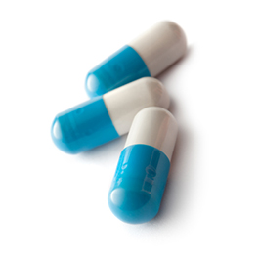

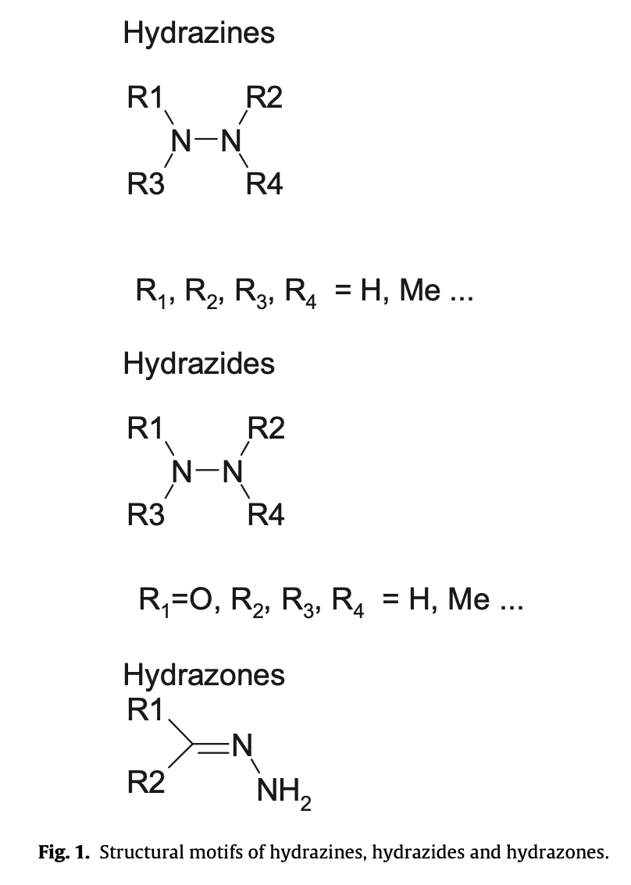
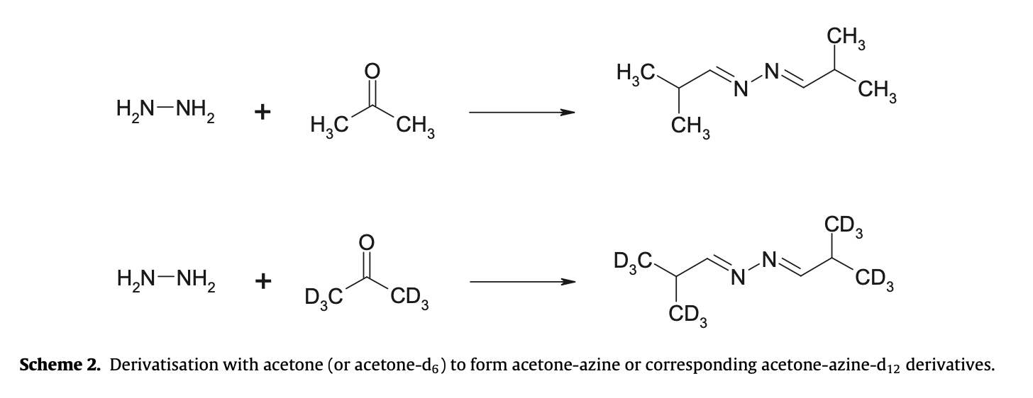
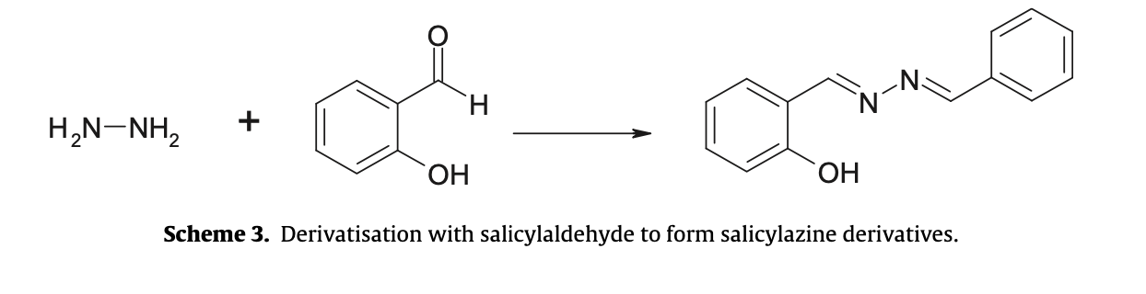
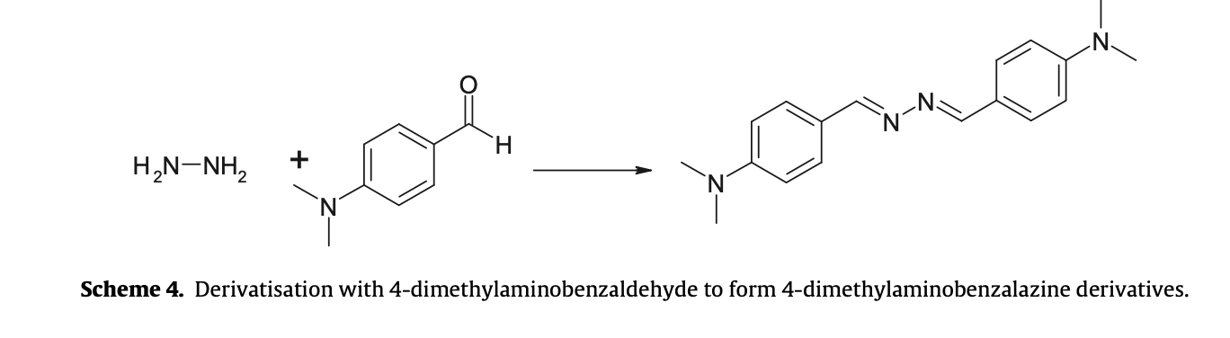
Hydrazine, Hydrazides and Hydrazones:
Genotoxic Impurities in API and Drug Products
Group 19 : WANG Jing LIU Ziqi JIN Cancan FENG Zixia VORWERK, Anna Mae
ABSTRACT
This study summarises the analytical approaches relating to hydrazine, hydrazines, hydrazides and hydrazones.
Intended to provide guidance for analysts needing to develop procedures to control such impurities, particularly where this is due to concerns relating to their potential genotoxicity.
Several generic methodologies, covering the three main analytical approaches:
HPLC (high performance liquid chromatography), GC (gas chromatography) ,IC (ion chromatography)
INTRODUCTION
Trace Analysis
Issues relating to safe levels of genotoxic impurities (GIs) in novel and generic Active Pharmaceutical Ingredients (APIs) and drug products have received considerable attention in the recent past.
Metabolism of hydrazine is complex. Hydrazine is rapidly acetylated in most species. The initial mono-acetylation is too fast to measure for resultant metabolite identification and the excreted diacetyl metabolite has been reported to account for the majority of the administered dose.
The principal hydrolytic degradation product of the anti-tuberculosis drug, isoniazid and of structurally related analogues: hydralazine, phenelzine and isocarboxazid
High performance liquid chromatography
(HPLC)
(Scheme 1): Kean et al. using a modified HPLC pharmacopoeial method involving derivatisation with benzaldehyde demonstrated linearity over the range 0.04–2ppm of residual hydrazine
The extraction recovery was reported as 92%.
Applied this quantitative HPLC method to the determination of residual hydrazine in samples of excipients and API
Gas Chromatography(GC)
(Scheme 1) A GC procedure: formation of a benzalazine derivative was developed to monitor the residual levels of hydrazine in hydralazine and isoniazid API, tablets, combination tablets, syrups and injectable products
Utilized nitrogen selective detection.
The LOD of the method when applied to API was found to be ≤3 ppm of hydrazine.
Analytical Approaches
The levels of residual hydrazine in carbidopa API, using an IC method again with amperometric detection.
Concordance (3.9 ppm) with an approved TLC method (3.2ppm), but different levels to the HPLC method
On generic IC methods for hydrazine and methyl hydrazine in API utilizing electrochem- ical/amperometric detection methods. Limited validation was provided.
Alkylating agents: Hydrazine and methyl-hydrazine
The formation of methyl adducts with DNA: one of the mechanisms by which hydrazines cause DNA damage and gene mutations .
Known human carcinogens: Hydrazine, methyl hydrazine and related hydrazides
Conventional structural alerts for genotoxic potential
A structural alert for genotoxicity and no Amestest or other relevant data are available.
Ion Chromatography(IC)
Thin Layer Chromatography and High Performance Thin Layer Chromatography
Spectrophotometry
Investigated aldose reaction products of isoniazid&lactose by UV/visible spectrophotometry.
Derivatised the isoniazid with 2,3-dichloro-1,naphthaquinone and monitored the resultant coloured derivative at 640 nm.
Conclusion:
Considering challenges inherent in the determination of low levels of volatile, reactive hydrazines and related compounds in APIs, the breadth of analytical techniques utilized is striking.
Derivatisation has been utilized as one of the main analytical strategies and this has ensured that spectrophotometric, as well as chromatographic (HPLC, GC, TLC, and IC) and electro-chromatographic methods (CE, MEKC and MEEKC) have been widely applied.
HPLC : A key separation technique and the favoured derivative using this approach has been benzalazine.
Reference: [1]. Elder, D.P., Snodin, D., & Teasdale, A. (2010). Control and analysis of hydrazine, hydrazides and hydrazones—Genotoxic impurities in active pharmaceutical ingredients (APIs) and drug products. Journal of Pharmaceutical and Biomedical Analysis, 54(2), 182-191. doi:10.1016/j.jpba.2010.11.007

